Slide 1
Strategies and Tools for Fake Messages in digital world
Team Details
B.Dinesh kumar ( 20EG105604)
B.Sreeja ( 20EG105607)
B.Shushanth ( 20EG105642)
Dr. N. Swapna Goud
Assistant Professor,CSE

Slide 2
Introduction
In recent years, due to the booming development of online social networks, fake messages for various commercial and political purposes has been appearing in large numbers and widespread in the online world.
With deceptive words, online social network users can get infected by these online fake news easily, which has brought about tremendous effects on the offline society already.
An important goal in improving the trustworthiness of information in online social networks is to identify the fake news timely. This project aims at investigating the principles, methodologies and algorithms for detecting fake news articles, creators and subjects from online social networks and evaluating the corresponding performance. Information preciseness on Internet, especially on social media, is an increasingly important concern, but web-scale data hampers, ability to identify, evaluate and correct such data, or so called "fake news," present in these platforms.

Slide 3
Problem Statement
Classification of any fake message item /post / blog into fake or real one has generated great interest from researchers around the globe.
Several research studies have been carried out to find effect of falsified and fabricated news on masses and reactions of people upon coming through such news items.
Falsified message or fabricated post message is any textual or non-textual content that is fake and is generated so the readers will start believing in something which is not true

Slide 4
Experiment environment
Operating System – Windows XP:
In our experimental setup using Windows XP, we're exploring cloud-based secure message management system in the digital world. We're virtualizing XP for compatibility and security, integrating cloud frameworks like simulating social media platform scenarios. Security measures are crucial due to XP's vulnerabilities. Through controlled experiments and thorough documentation, we aim to evaluate the effectiveness of our solution, with contingency plans in place for any technical challenges.

Slide 5
Coding Languages:
python:
In python experiment environment, we're crafting a cloud-based secure messaging system.Python is used in fake message detection for data collection, preprocessing, feature extraction, model training, evaluation, deployment, and automation. It employs libraries like NLTK, scikit-learn, and frameworks like Flask for various tasks, ensuring efficient processing and analysis of text data to identify misinformation.

Slide 6
Front End:
The frontend of fake message detection involves creating a web-based interface using HTML, CSS, and JavaScript. Users input text or URLs for analysis, with elements like input fields and buttons facilitating interaction. JavaScript fetch API communicates user inputs to the backend Python server for processing via HTTP requests. Results, such as classification outcomes (genuine or fake), are displayed to users, potentially utilizing visualizations like progress bars. Integration with backend APIs enables seamless data exchange. Accessibility considerations ensure inclusivity, while compatibility testing across browsers and devices ensures a consistent user experience. Deployment on web servers or cloud platforms makes the frontend accessible to users globally.

Slide 7
Back End:
MySQL:
MySQL is utilized in the fake message detection project as a backend database. It stores user data, including authentication details and roles, and houses collected messages with metadata for analysis. Model training results are recorded for comparison, aiding in model selection. System logs track activities for auditing and troubleshooting purposes. Python's MySQL Connector enables seamless integration with the backend server, facilitating data retrieval and manipulation through SQL queries. Security measures, including authentication mechanisms and parameterized queries, ensure data integrity. Regular backups and maintenance tasks optimize database performance, safeguarding against data loss and ensuring system reliability.

Slide 8
We are creating the front-end web page like home page, cloud, user, owner, upload files, view request, view files, download files, message status and logout. We are using MySQL database for storing the data.
We are correctly able to login the user and register the user. By using this, the user is able to login into his page and he can upload files in secure and safe. which is used to keep our data and communication safe between users.

Slide 9
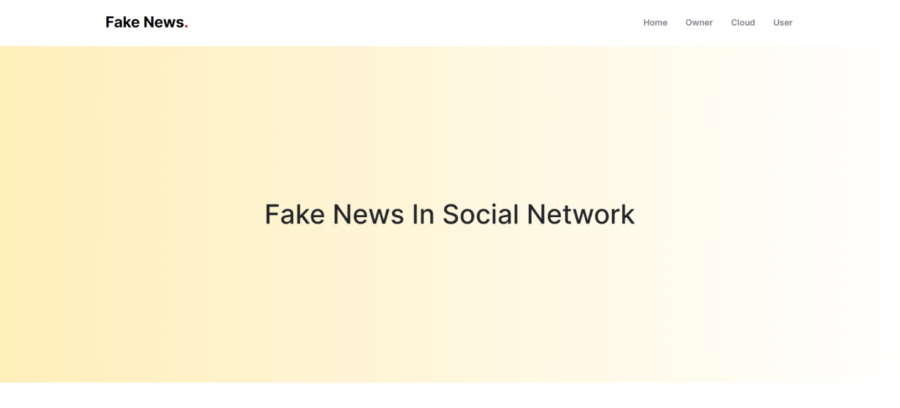

Slide 10
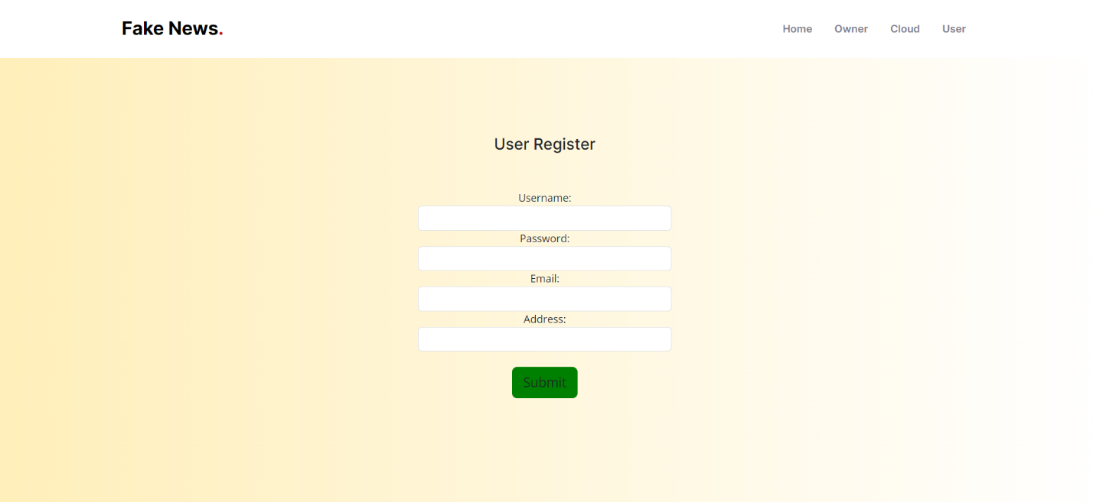

Slide 11
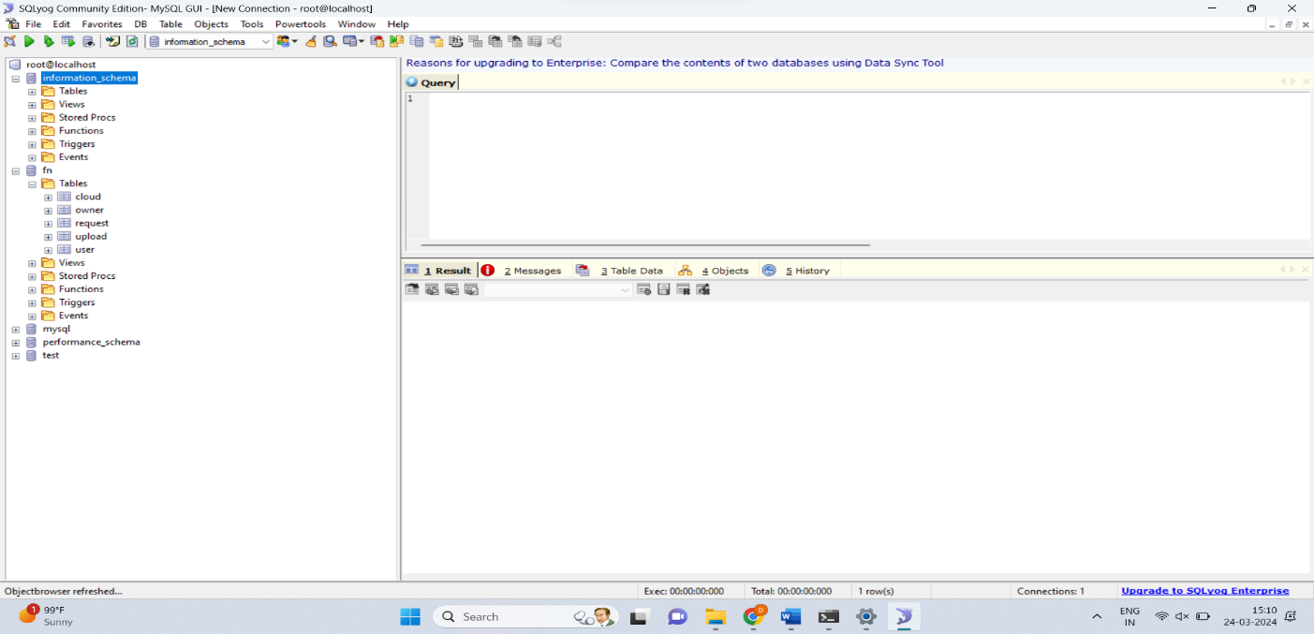

Slide 12
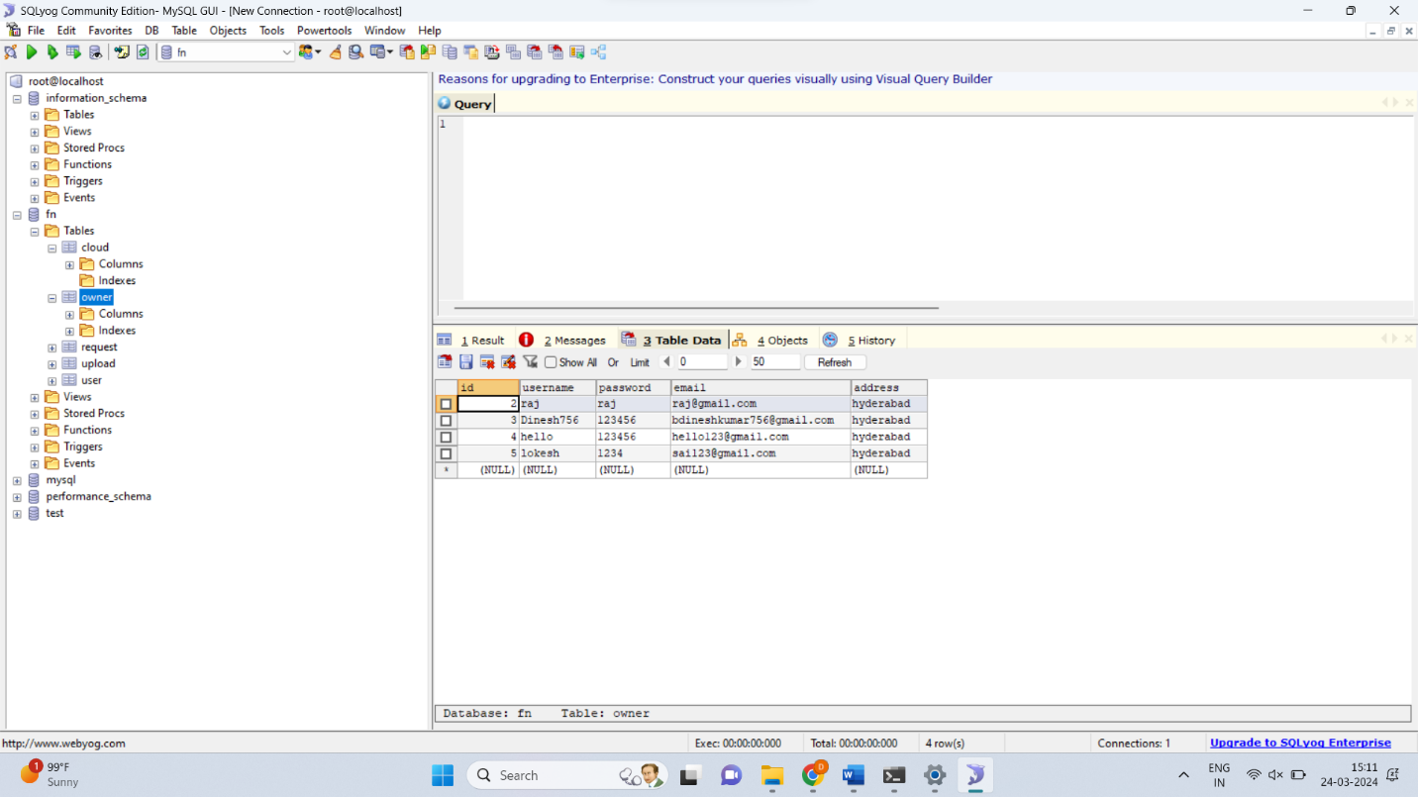

Slide 13
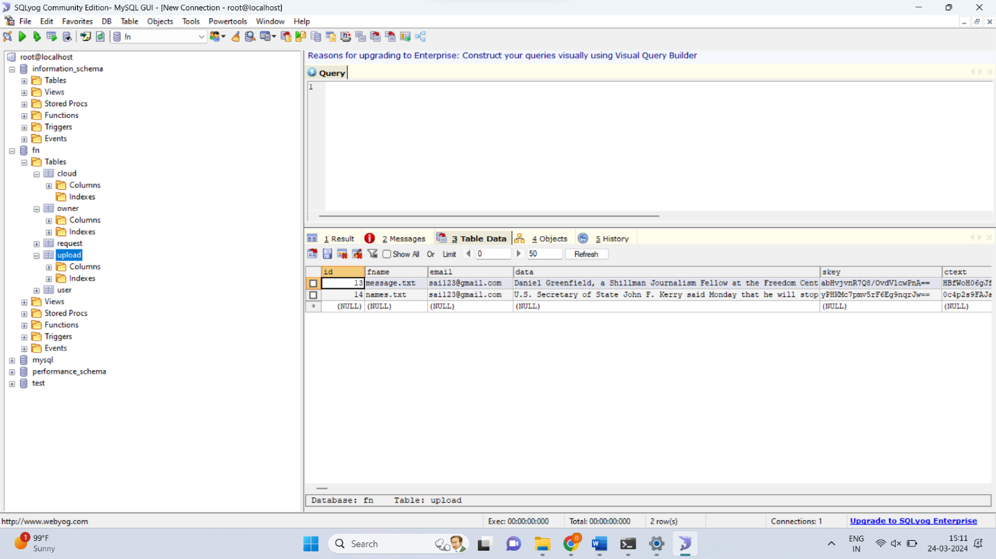

Slide 14
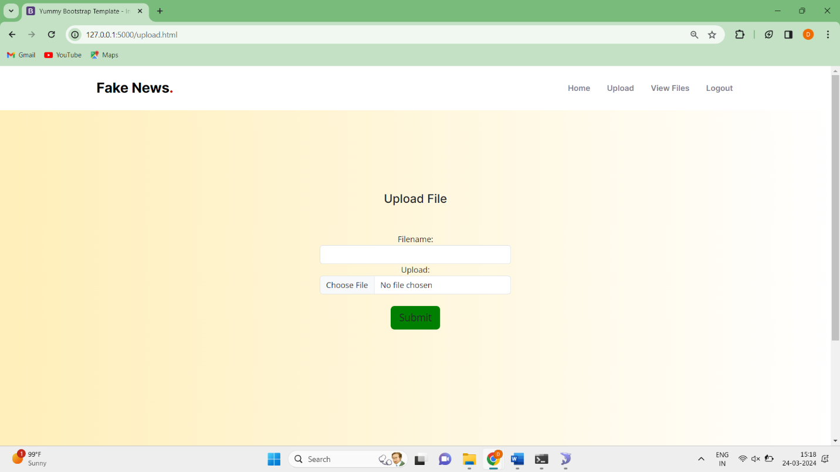

Slide 15
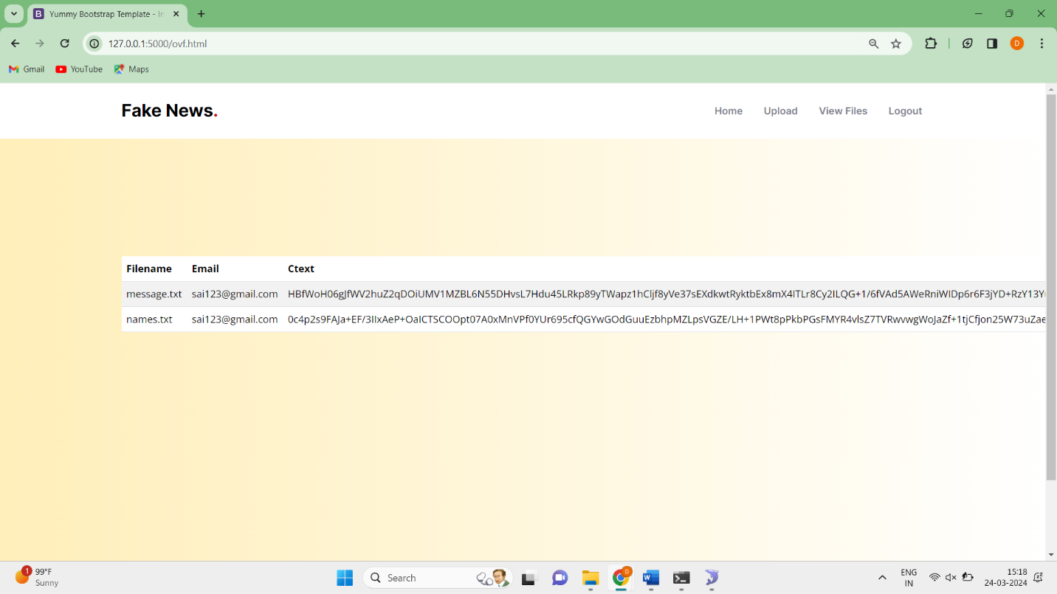

Slide 16
conclusion
In conclusion, harnessing the synergy between Python and cloud computing provides a robust solution for detecting fake messages on social media platforms like Twitter. By leveraging Python's versatile libraries and tools for data processing, machine learning, and social network analysis, coupled with the scalability and efficiency of cloud computing resources, organizations can develop highly effective detection systems. The integration of Python allows for sophisticated preprocessing of tweet data, feature extraction, and model training, while cloud computing platforms offer scalable infrastructure for real-time analysis, model deployment, and continuous monitoring. This approach enables organizations to handle the vast volume of social media data with ease, while also benefiting from the flexibility and cost-effectiveness of cloud-based solutions.

Slide 17
Experiment Environment
Software Requirements:
Operating System - Windows XP
Coding Language - python
Front End - Html,css
IDE - Anaconda
Back End - MySQL

Slide 18
Project status
S.No | Functionality | Status (Completed /in-progress/Not started)
1 | Data collection | Completed
2 | Data split and train model | Completed
3 | Accuracy of model is calculated | Started
4 | Web application html pages using flask | pending

Slide 19
References
Niall J Conroy, Victoria L Rubin and Yimin Chen, "Automatic deception detection: Methods for finding fake news", Proceedings of the Association for Information Science and Technology, vol. 52, no. 1, pp. 1-4, 2015.
Mykhailo Granik and Volodymyr Mesyura, "Fake news detection using naive bayes classifier", 2017 IEEE First Ukraine Conference on Electrical and Computer Engineering (UKRCON), pp. 900-903, 2017.
Junaed Younus Khan, Md Khondaker, Tawkat Islam, Anindya Iqbal and Sadia Afroz, A benchmark study on machine learning methods for fake news detection, 2019, [online] Available: .
Cédric Maigrot, Ewa Kijak and Vincent Claveau, "Fusion par apprentissage pour la détection de fausses informations dans les réseaux sociaux", Document numerique, vol. 21, no. 3, pp. 55-80, 2018.
D S K R Vivek Singh and Rupanjal Dasgupta, Automated fake news detection using linguistic analysis and machine learning.

Slide 20
Thank you

Slide 21
Project seminar–I Evaluation
S.No | Rubrics | Marks
1 | Concept Introduction | 4
2 | Literature and Parameter | 5
3 | Problem and Problem Illustration | 8
4 | Proposed Method and Illustration | 8
Total |  | 25

